Slide 1
Lecture 04 Machine Language I COMP1411: Introduction to Computer Systems
Dr. Mingsong LYU (呂鳴松)
Department of Computing,
The Hong Kong Polytechnic University
Spring 2023
Acknowledgement: These slides are based on the textbook (Computer Systems: A Programmer’s Perspective) and its slides.
These slides are only intended to use internally. Do not publish it anywhere without permission.

Slide 2
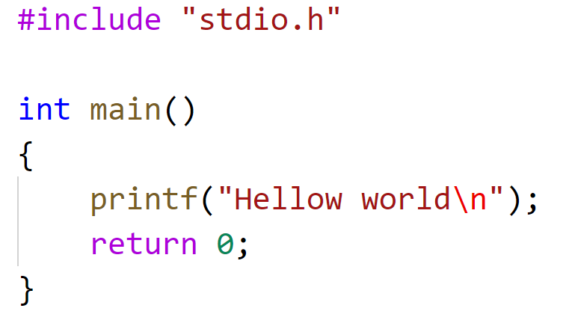
A first look at machine code
What is the program that actually runs on a CPU hardware?
What do we do in lab sessions?
Write a source code hello.c
gcc hello.c –o hello
./hello
Let’s look into the “hello” program
First, with a binary viewer software
Second, look into “hello”: objdump –D hello > hello-exe
gcc –save-temps hello.c –o hello

Slide 3
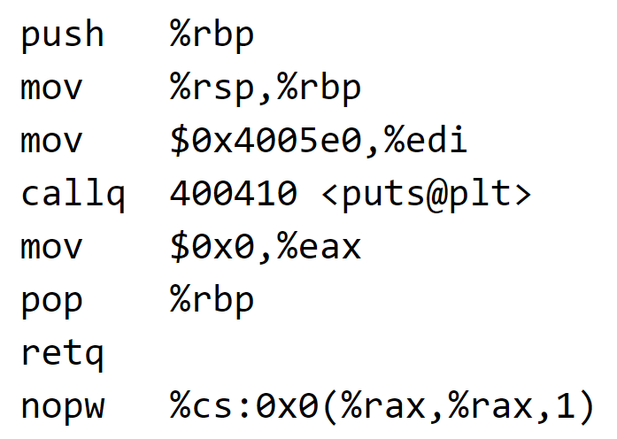
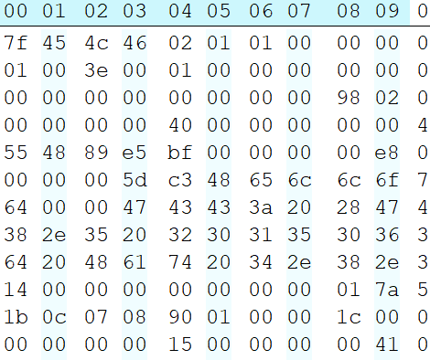
A first look at machine code
printf.o
Pre-
processor
(cpp)
Compiler
(cc1)
Assembler
(as)
Linker
(ld)
hello.c
hello.i
hello.s
hello.o
hello
Source
program
(text)
Modified
source
program
(text)
Assembly
program
(text)
Relocatable
object
programs
(binary)
Executable
object
program
(binary)
LEC04, LEC05
LEC06

Slide 4








Why learning machine code?
Many years ago, people write programs with machine code
Nowadays, people write programs with high-level languages, because they are easy to understand by human beings
compilers do the dirty work (high-level code → machine code)
To write a program that runs is easy
To write a program that runs well (reliable and fast), you need to understand how the machine execute programs
We are CS students, we are supposed to understand the principles of computer programs

Slide 5
Outline
Basic definitions on machine code
Registers and operands
Moving data between memory and CPU
Arithmetic and logical operations
Control
Conditional branches
Loops
Switch statements

Slide 6
Definitions
Code Forms
Machine Code: The byte-level programs that a processor executes
Assembly Code: A text representation of machine code
Each line of the assembly code is called a machine instruction

Slide 7
The program and its execution
A program is a set of instructions
The execution of a program is the execution of a sequence of instructions which operates on input data and produced output data
A sequence of instructions → cookbook
Input data → vegetables, meat, ingredients
Output data → the dish

Slide 8
Instruction Set Architecture – ISA
Instruction set architecture – ISA
An abstract model of a computer, ISA defines a class of computers
an ISA defines the supported instructions, data types, registers, the hardware support for managing main memory, fundamental features, and the input/output model of a family of implementations of the ISA
Examples: instruction set specification, registers
We will mainly focus on the x86-64 architecture
Roughly speaking, if two CPUs have the same ISA, the instructions that can run on one CPU can also run on the other CPU

Slide 9
The not-so-black-box computer
The CPU
Arithmetic & Logic Unit (ALU): the device to do computation
Registers: temporarily store data inside the CPU
PC: a special register stores the address of the next instruction to execute
The memory
Byte addressable array, stores both instructions and data
CPU fetches both instructions and data from the memory, and stores computed data to the memory
Accessing memory needs to know the target address
0x0000
0x0010
0x0020
0x0030
0x0040
0x0050
0x0060
0x0070
Register
file
ZF
SF
OF
ADDRESS
PC
A
DATA
A
L
U
B
OF
INSTRUCTIONS
ZF
CF

Slide 10
Machine instruction example
C Code
Add two signed integers: x, y
And store the result in x
Assembly
addl: Add 2 4-byte integers
Operands:
x: Register %eax
y: Memory M[%ebp]
Object Code
3-byte instruction
Stored at address 0x80483ca
int x = x + y;
addl (%ebp),%eax
0x80483ca: 03 45 08

Slide 11
Outline
Basic definitions on machine code
Registers and operands
Moving data between memory and CPU
Arithmetic and logical operations
Control
Conditional branches
Loops
Switch statements

Slide 12
Data types
The size of a data item
“word” in x86-64 ISA
Word: 2 bytes
Double words: 4 bytes
Quad words: 8 bytes
C declaration | Intel data type | Assembly code suffix | Size (bytes)
char | Byte | b | 1
short | Word | w | 2
int | Double word | l | 4
long | Quad word | q | 8
char * | Quad word | q | 8
float | Single precision | s | 4
double | Double precision | l | 8

Slide 13
X86-64 registers
63
31
15
7
0
%rax
%eax
%ax
%al
%rbx
%ebx
%bx
%bl
%rcx
%ecx
%cx
%cl
%rdx
%edx
%dx
%dl
%rsi
%esi
%si
%sil
%rdi
%edi
%di
%dil
%rbp
%ebp
%bp
%bpl
%rsp
%esp
%sp
%spl

Slide 14
X86-64 registers
63
31
15
7
0
%r8
%r8d
%r8w
%r8b
%r9
%r9d
%r9w
%r9b
%r10
%r10d
%r10w
%r10b
%r11
%r11d
%r11w
%r11b
%r12
%r12d
%r12w
%r12b
%r13
%r13d
%r13w
%r13b
%r14
%r14d
%r14w
%r14b
%r15
%r15d
%r15w
%r15b

Slide 15
Using different names to access different parts of a register
63
31
15
7
0
%rax
%eax
%ax
%al
%rax = 00000000111100110000111100000111 0000000000000000 11111111 00000000
quad word
double word
%eax = 0000000000000000 11111111 00000000
word
%eax = 11111111 00000000
byte
%al = 00000000

Slide 16
Outline
Basic definitions on machine code
Registers and operands
Moving data between memory and CPU
Arithmetic and logical operations
Control
Conditional branches
Loops
Switch statements

Slide 17
Moving data
Instructions for moving data
mov* Source, Destination
Direction: from source to destination
Moving different data sizes: movq, movl, movw, movb
Operand Types (basically, where data are stored)
Immediate: Constant integer data
Example: $0x400, $-533
Like C constant, prefixed with $ in the assembly code
Register: One of 16 integer registers
Example: %rax, %r13
But %rsp reserved for special use
Others have special uses for particular instructions
Memory: 8 consecutive bytes of memory at address given by register
Simplest example: (%rax)
Various other “address modes”

Slide 18
Moving data
Instructions for moving data
mov* Source, Destination
Take movq for example, movq means the size of the data item is 8 bytes
From | To | Instruction | Equivalent C code | Notes
Memory | Register | movq (%rax),%rdx | temp = *p; | temp in %rdx *p = %rax
Register | Memory | movq %rax,(%rdx) | *p = temp; | temp in %rax *p = %rdx
Register | Register | movq %rax,%rdx | temp2 = temp1; | temp1 in %rax temp2 in %rdx
Number | Register | movq $0x4,%rax | temp = 4; | temp in %rax
Number | Memory | movq $-147,(%rax) | *p = -147; | *p = %rax
Cannot do memory-memory transfer with a single instruction!

Slide 19
An example of moving data
Pointers in C language
Assume that all variables are stored in the memory, in this page
Declaring a pointer variable
int a, b, c, d;
int *pa, *pb;
a = 17; b = 25;
Assigning value to a pointer variable
*pa = &a;
*pb = &b;
Get the value of a data item pointed by a pointer variable
c = *pa;
d = *pb;
Address
Memory
0x00000010
17
a
0x00000014
25
b
0x00000018
17
c
0x0000001C
25
d
0x00000020
0x00000010
pa
0x00000024
0x00000014
pb

Slide 20
An example of moving data
Swapping the data in two different memory addresses
void swap(long *xp, long *yp)
{
long t0 = *xp;
long t1 = *yp;
*xp = t1;
*yp = t0;
}
xp : the address of the first data item
yp : the address of the second data item
*xp : the first data item
*yp : the second data item
swap:
movq (%rdi), %rax # t0 = *xp
movq (%rsi), %rdx # t1 = *yp
movq %rdx, (%rdi) # *xp = t1
movq %rax, (%rsi) # *yp = t0
ret
Register Value
%rdi xp
%rsi yp
%rax t0
%rdx t1

Slide 21
An example of data moving
Memory
Registers
Address
123
0x120
%rdi
0x120
0x118
%rsi
0x100
0x110
%rax
0x108
%rdx
456
0x100
swap:
movq (%rdi), %rax # t0 = *xp
movq (%rsi), %rdx # t1 = *yp
movq %rdx, (%rdi) # *xp = t1
movq %rax, (%rsi) # *yp = t0
ret
Register Value
%rdi xp
%rsi yp
%rax t0
%rdx t1

Slide 22
An example of data moving
Memory
Registers
Address
123
0x120
%rdi
0x120
0x118
%rsi
0x100
0x110
%rax
123
0x108
%rdx
456
0x100
swap:
movq (%rdi), %rax # t0 = *xp
movq (%rsi), %rdx # t1 = *yp
movq %rdx, (%rdi) # *xp = t1
movq %rax, (%rsi) # *yp = t0
ret
Register Value
%rdi xp
%rsi yp
%rax t0
%rdx t1

Slide 23
An example of data moving
Registers
Address
123
0x120
%rdi
0x120
0x118
%rsi
0x100
0x110
%rax
123
0x108
%rdx
456
456
0x100
swap:
movq (%rdi), %rax # t0 = *xp
movq (%rsi), %rdx # t1 = *yp
movq %rdx, (%rdi) # *xp = t1
movq %rax, (%rsi) # *yp = t0
ret
Register Value
%rdi xp
%rsi yp
%rax t0
%rdx t1

Slide 24
An example of data moving
Memory
Registers
Address
456
0x120
%rdi
0x120
0x118
%rsi
0x100
0x110
%rax
123
0x108
%rdx
456
456
0x100
swap:
movq (%rdi), %rax # t0 = *xp
movq (%rsi), %rdx # t1 = *yp
movq %rdx, (%rdi) # *xp = t1
movq %rax, (%rsi) # *yp = t0
ret
Register Value
%rdi xp
%rsi yp
%rax t0
%rdx t1

Slide 25
An example of data moving
Memory
Registers
Address
456
0x120
%rdi
0x120
0x118
%rsi
0x100
0x110
%rax
123
0x108
%rdx
456
123
0x100
swap:
movq (%rdi), %rax # t0 = *xp
movq (%rsi), %rdx # t1 = *yp
movq %rdx, (%rdi) # *xp = t1
movq %rax, (%rsi) # *yp = t0
ret
Register Value
%rdi xp
%rsi yp
%rax t0
%rdx t1

Slide 26
Memory addressing modes
Different ways to describe a memory address
General Form: D(Rb,Ri,S) → address = Reg[Rb] + S*Reg[Ri] + D
D: Constant “displacement” 1, 2, or 4 bytes
Rb: Base register: Any of 16 integer registers
Ri: Index register: Any, except for %rsp
S: Scale: 1, 2, 4, or 8
%rdx | 0xf000
%rcx | 0x0100
Expression | Address Computation | Memory Address
(%rdx) | 0xf000 | 0xf000
0x8(%rdx) | 0xf000 + 0x8 | 0xf008
(%rdx,%rcx) | 0xf000 + 0x100 | 0xf100
(%rdx,%rcx,4) | 0xf000 + 4*0x100 | 0xf400
0x80(,%rdx,2) | 2*0xf000 + 0x80 | 0x1e080

Slide 27
Outline
Basic definitions on machine code
Registers and operands
Moving data between memory and CPU
Arithmetic and logical operations
Control
Conditional branches
Loops
Switch statements

Slide 28
Some arithmetic operations
Two Operand Instructions
Format Computation
addq Src,Dest Dest = Dest + Src
subq Src,Dest Dest = Dest − Src
imulq Src,Dest Dest = Dest * Src
salq Src,Dest Dest = Dest << Src Also called shlq
sarq Src,Dest Dest = Dest >> Src Arithmetic
shrq Src,Dest Dest = Dest >> Src Logical
xorq Src,Dest Dest = Dest ^ Src
andq Src,Dest Dest = Dest & Src
orq Src,Dest Dest = Dest | Src
Watch out for argument order!
No distinction between signed and unsigned int (why?)

Slide 29
Some arithmetic operations
One Operand Instructions
incq Dest Dest = Dest + 1
decq Dest Dest = Dest − 1
negq Dest Dest = − Dest
notq Dest Dest = ~Dest (bit-wise inversion)
Note that executing different instructions takes different time
Please check the costs of instructions here https://www.agner.org/optimize/instruction_tables.pdf (see pages 222-236 for Intel Broadwell CPU)

Slide 30
Thank You

